Slide 1
Business Analytics
Toolbox - BA775
Summer 2021
Lecture 01
Professor: Mohammad Soltanieh-ha

Slide 2


Slide 3
Introduction
Mohammad Soltanieh-ha <msoltani@bu.edu>
Office: HAR 633A
Teaching:
Big Data Analytics for Business
Business Analysis
Computer vision
R & Python Programming
Research:
Image classification in cancer research
High performance cloud computing

Slide 4

Introduce Yourself
What name do you prefer to be called?
Which school are you coming from?
What is your favorite programming language?

Slide 5

Course Objectives
Cloud computing with Google Cloud (GCP)
Standard SQL language
Dashboarding and reporting tools
Basic machine learning models

Slide 6
Course Logistics

Slide 7
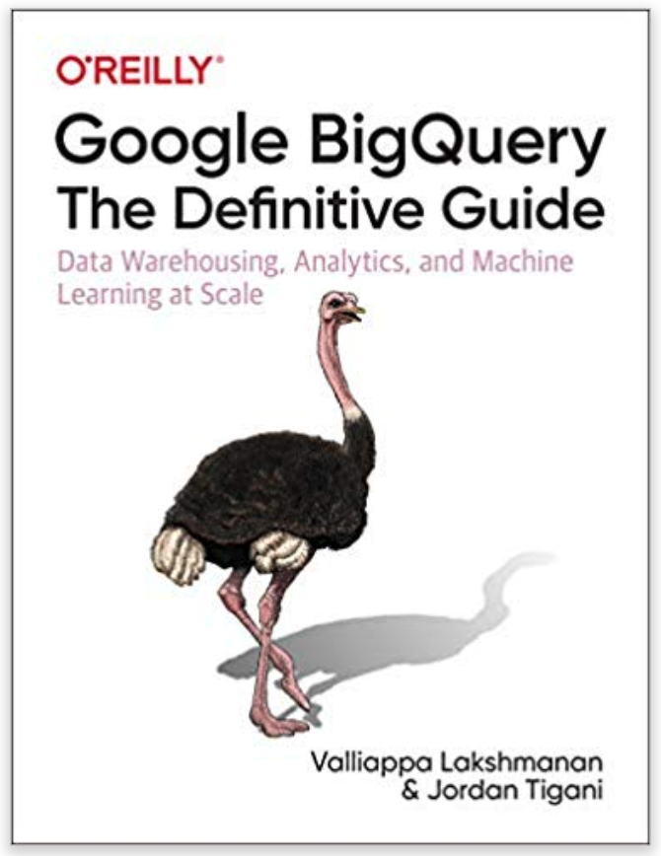
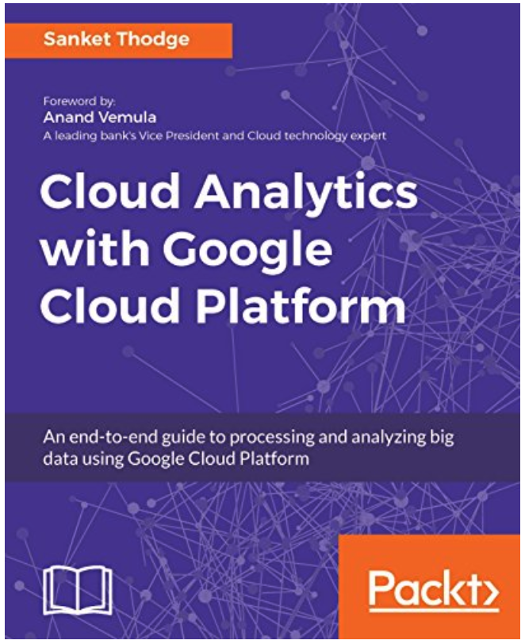
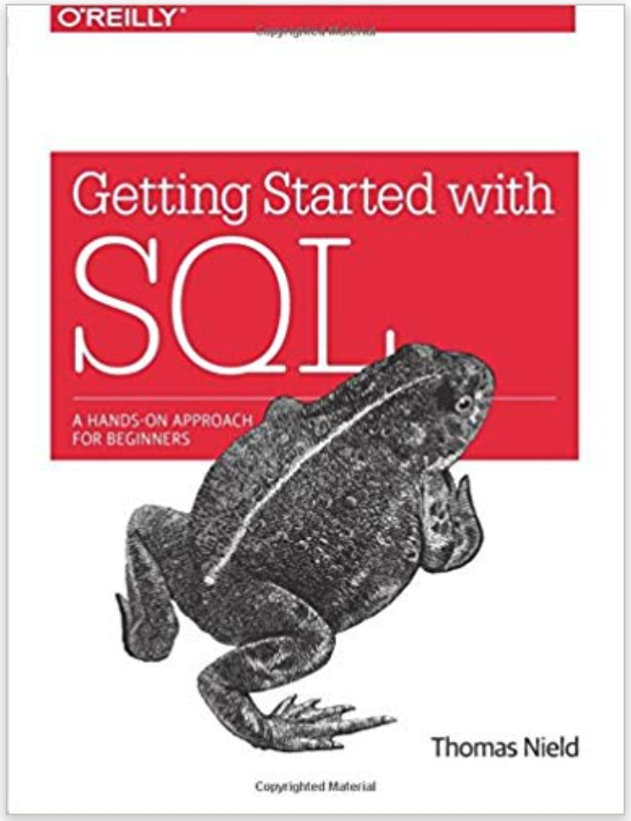
Book
Google BigQuery: The Definitive Guide
Safari Platform *
Amazon
Cloud Analytics with Google Cloud Platform
Safari Platform *
Amazon
Getting Started with SQL: A Hands-On Approach for Beginners
Safari Platform *
Amazon
* subscription required $39.99/month

Slide 8
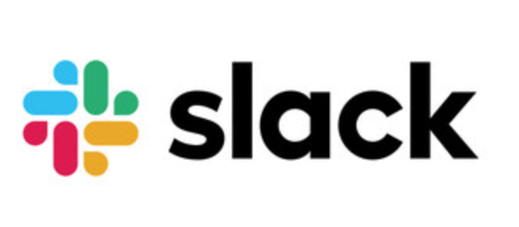
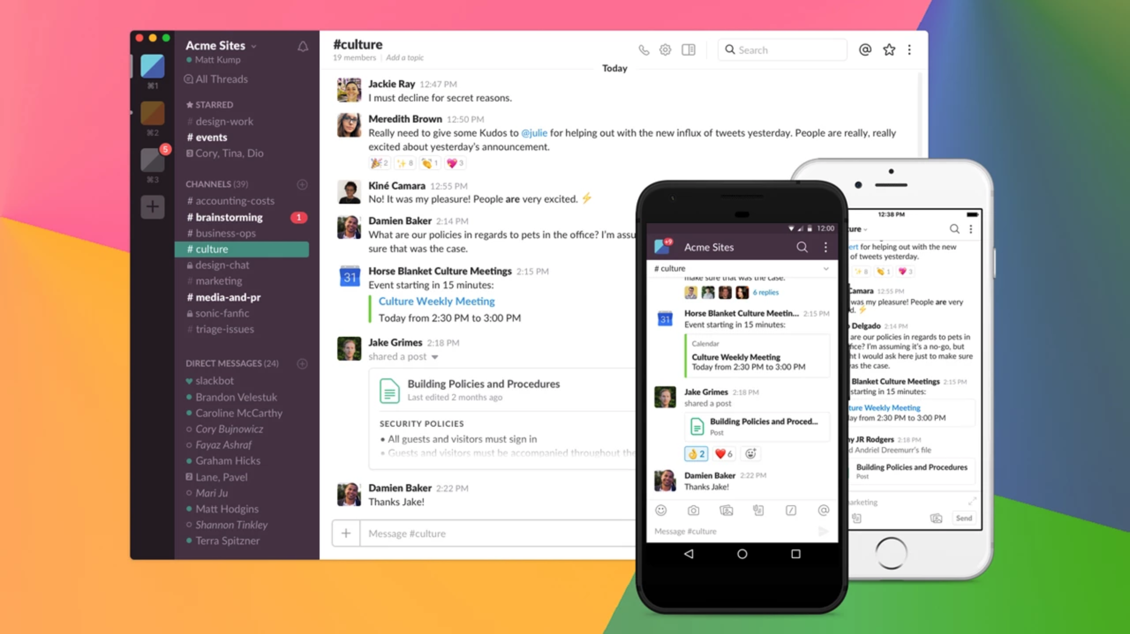
Slack Channel
ba775-summer21 Slack channel has been created and you were added.
You are encouraged to participate in Slack activities. Especially if you know the answer to someone else’s question; this will count towards your class contribution.
You will get a faster response compared to emails.
Your classmates could also benefit from your question and the discussion.
Get the desktop and/or mobile app

Slide 9
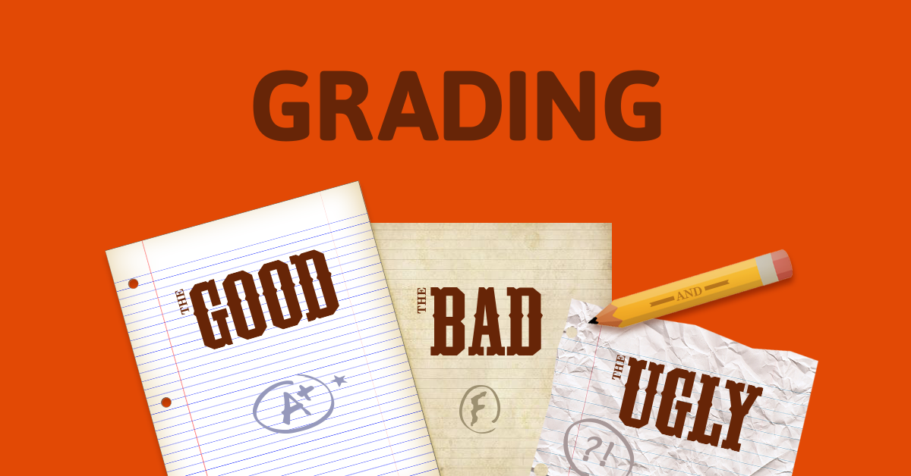
Grading
Activity | Fraction of Grade
Class Contribution and Participation | 15%
Qwiklabs | 15%
Individual Assignments | 15%
DataCamp | 15%
Quiz | 10%
Team Assignment | 10%
Team Project | 20%

Slide 10
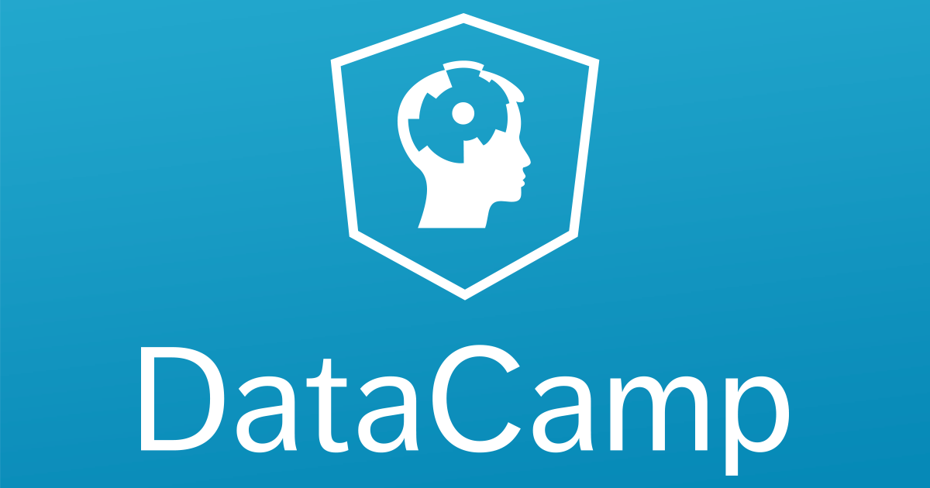
DataCamp
Use the invitation link sent to you in early August to sign up and get access to DataCamp materials and assignments.
Make sure to use your BU email address.

Slide 11

Qwiklabs
Please use this link to get access to free credits shared with you and your classmates.
You will be prompted to log into Qwiklabs. If you did not already have a Qwiklabs account, you’ll need to create one. Make sure you use your BU email address.
Qwiklabs assignments count as 15% of your overall grade. The labs should be completed before the next class. Submission instruction for Qwiklabs will be provided at the end of the course.
You also should have access to some credits for today if you use your BU account to log in to google.qwiklabs.com
**NOTE** ALWAYS OPEN QWIKLABS ON AN INCOGNITO MODE GOOGLE CHROME PAGE

Slide 12
More Credits
Use this link to apply for an additional 200 free personal credits. Make sure you use your BU email address.
Once you finish a GCP specialization on Coursera you can opt in to be recruited by Google and participating companies.
Suggested specializations:
From Data to Insights with Google Cloud Platform Specialization
Data Engineering, Big Data, and Machine Learning on GCP Specialization

Slide 13

Team Project
You will be working in groups of 5-6 people.
You will come up with the dataset and scope of your project and I will help you finalize it.
You will be presenting your project on the last class (Aug 31).
You will also be the “judge” for another team, acting as stakeholders.
We will talk about the team project in our class #4.

Slide 14
Quiz
Some of the morning classes will end with a 15-minute quiz. Quizzes are open-internet, as long as you are not consulting with another person. Questions are from the previous 2 classes or the recording for the same class.
Open: 11:30 a.m. ET - close: 5:30 p.m. ET
Duration: 30 minutes

Slide 15


Slide 16
Code + Data
Code and data are available on my GitHub repository(bit.ly/BU-BA775): https://github.com/soltaniehha/Business-Analytics-Toolbox
In order to clone this repo for the first use the following command:
git clone https://github.com/soltaniehha/Business-Analytics-Toolbox.git
In order to update the material after a new class use the following command within the Business-Analytics-Toolbox directory: git pull

Slide 17
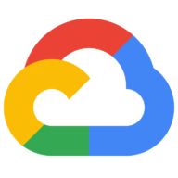
Topics Covered in This Lecture
Business Analytics
Google Cloud
Overview of GCP
Project setup
Budget and alert setup
Cloud Storage bucket
Cloud Compute Engine - A virtual machine (VM) instance
Vertex AI (AI Platform) Notebooks

Slide 18
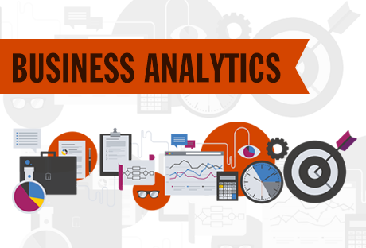
Business Analytics
Business analytics (BA) is the practice of iterative, systematic exploration of an organization's data, with an emphasis on statistical analysis. Business analytics is used by companies committed to data-driven decision-making.
BA is used to automate and optimize business processes.
Business analytics classification:
Descriptive analytics: What happened in the past?
Predictive analytics: What happens next?
Prescriptive analytics: What can be done to enhance the business process?

Slide 19

Cloud Computing

Slide 20
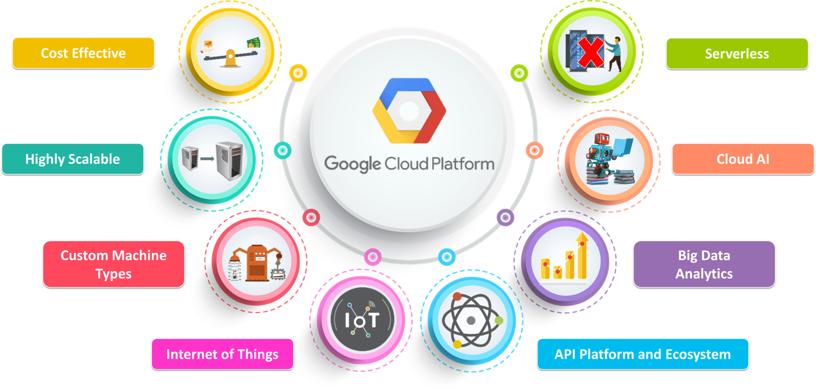
Why Cloud?

Slide 21
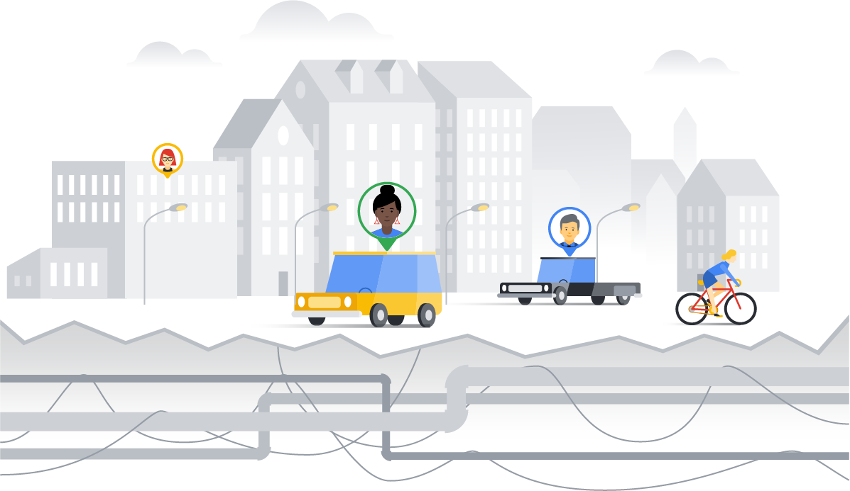
An IT infrastructure is like a "city infrastructure"
Users
Applications
Infrastructure
Copyright Google LLC. For educational purposes in accordance with the terms of use set forth on the program Website.

Slide 22
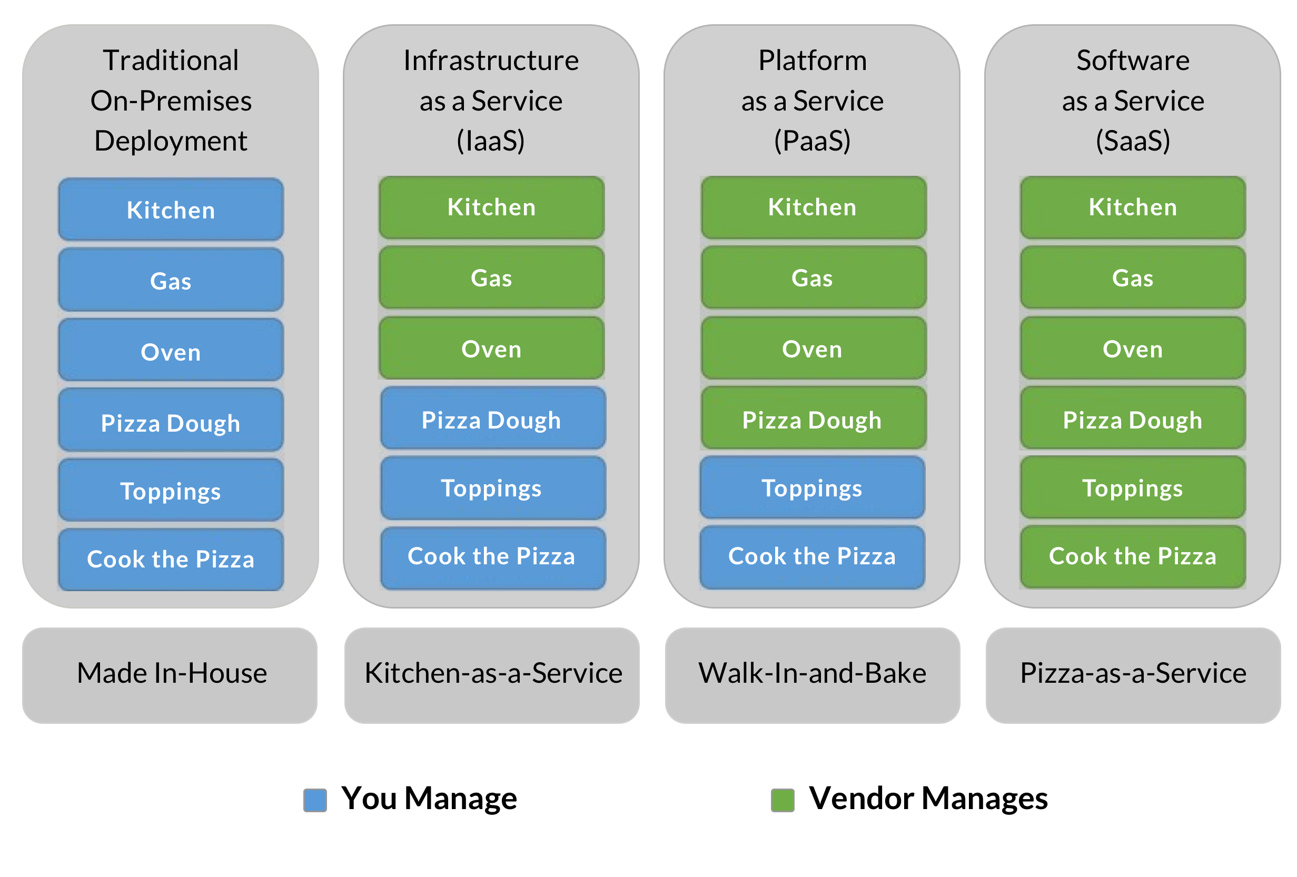

Pizza as a Service

Slide 23
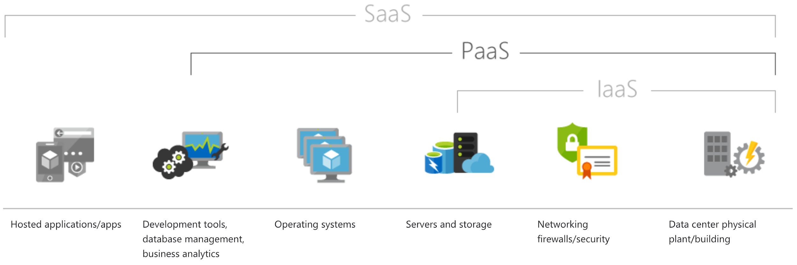
Cloud Computing - Service Models
Infrastructure as a service (IaaS)
Hardware related services
Google Compute Engine
Amazon EC2
Windows Azure
Platform as a Service (PaaS)
Development platform on cloud
Google’s App Engine, Vertex AI
Software as a service (SaaS)
Offering a complete software on cloud
Gmail, Microsoft Office 365
Serverless computing
Database as a service: Google BigQuery
Function as a service (FaaS)

Slide 24
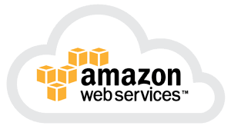

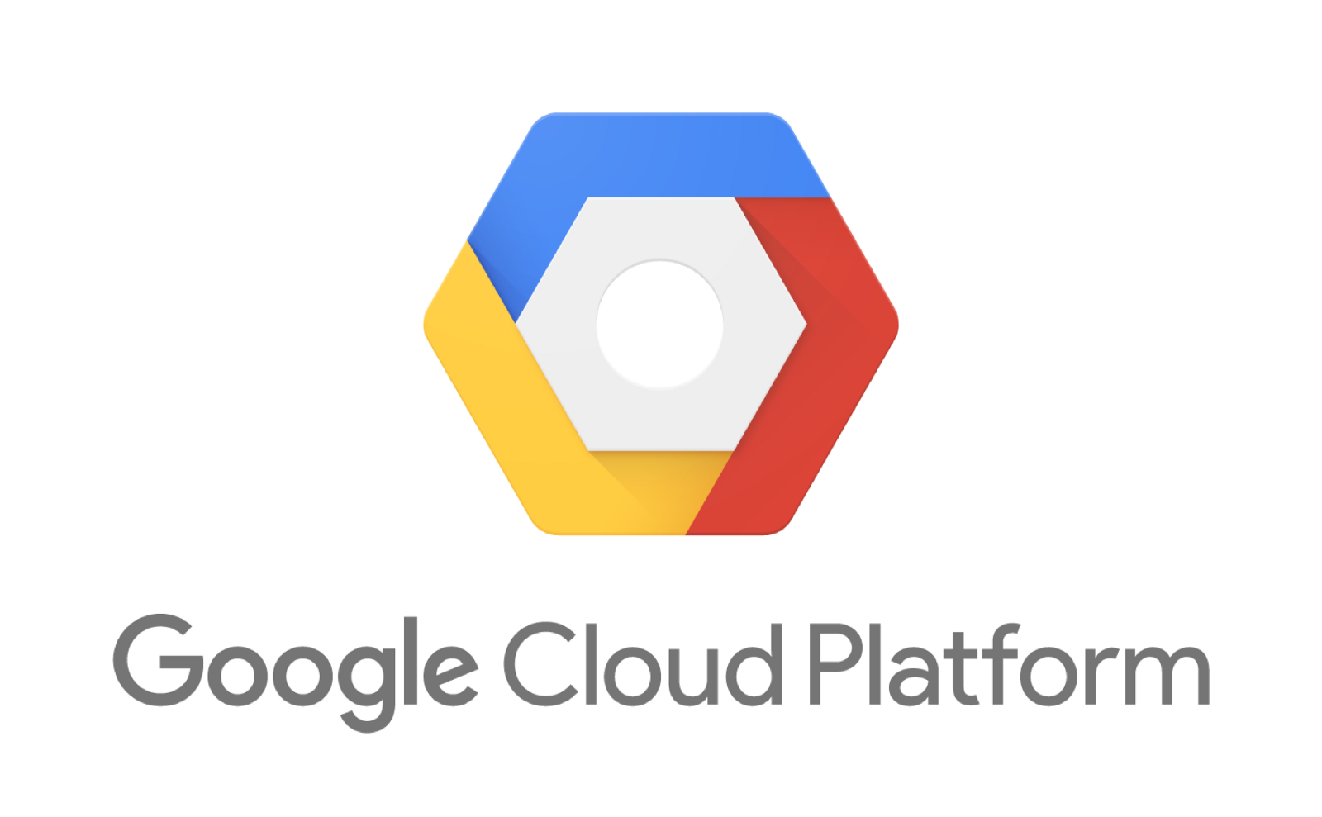
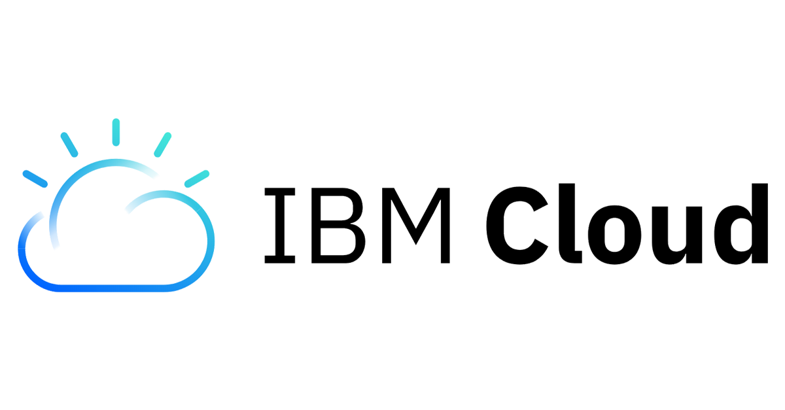
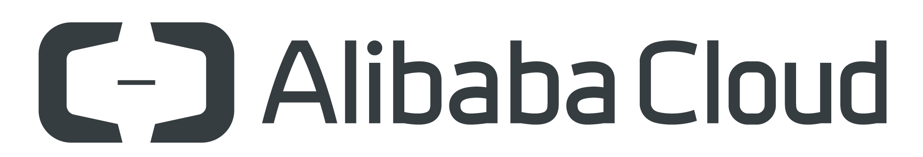
Popular Cloud Platforms
Amazon Web Services - AWS
Microsoft Azure
Google Cloud Platform - GCP
IBM Cloud
Alibaba Cloud

Slide 25
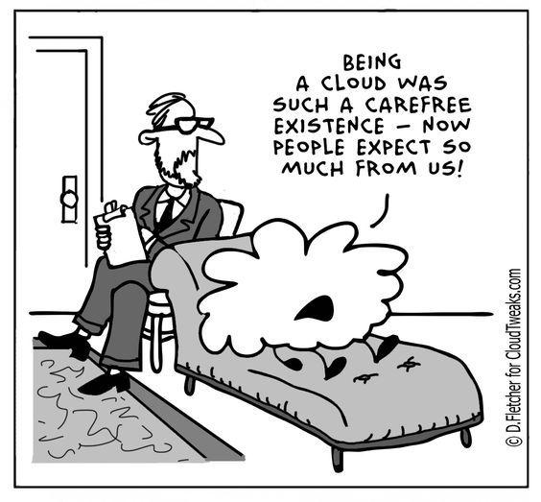
What Cloud Services Are Available?

Slide 26
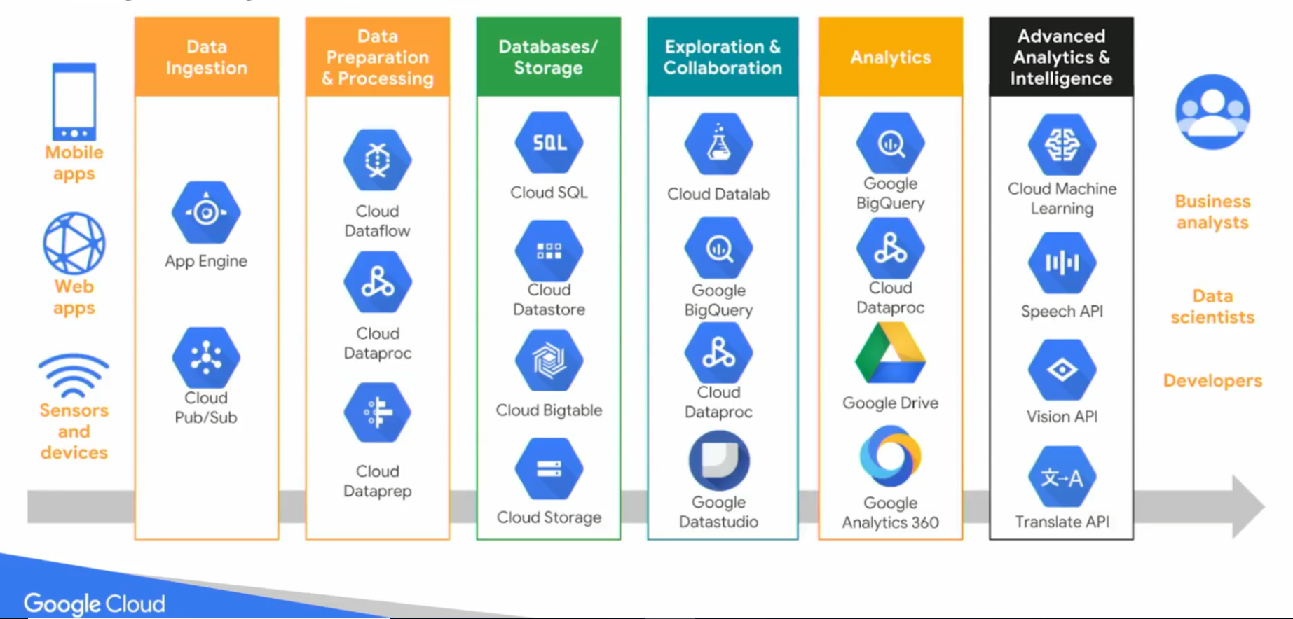
Google Cloud - Services

Slide 27
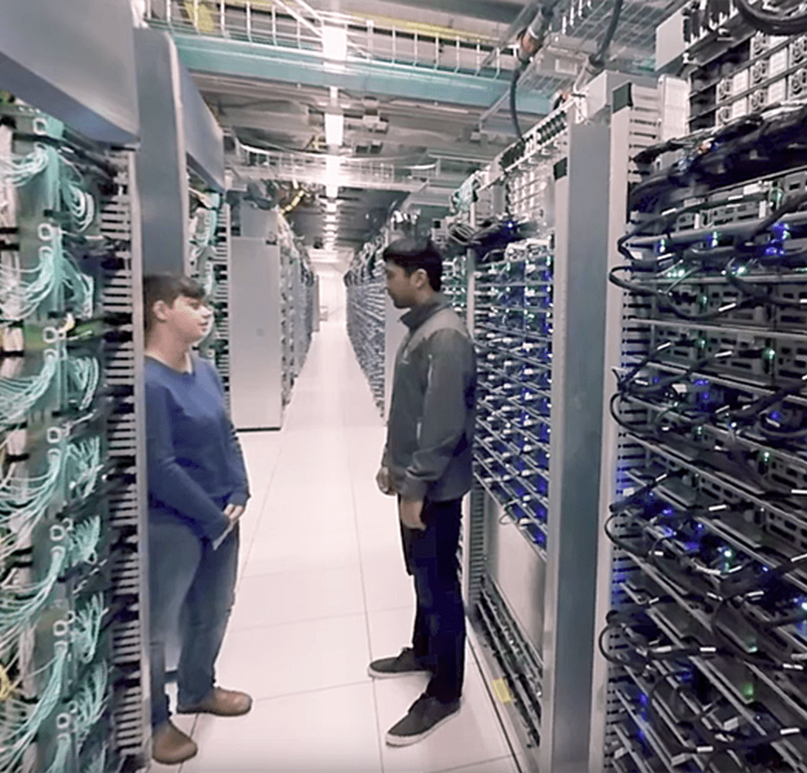
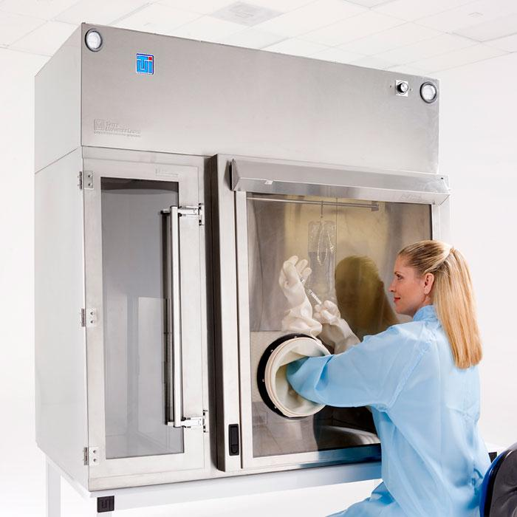
Leave Your Data in the Cloud

Slide 28
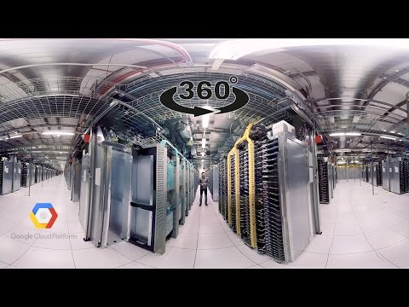
Google Data Center

Slide 29

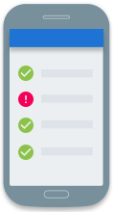
There are four ways to interact with GCP
>_
Google Cloud Platform Console
Web user interface
Cloud SDK and Cloud Shell
Command-line interface
REST-based
API
For custom applications
Cloud Console mobile app
For iOS and Android
Copyright Google LLC. For educational purposes in accordance with the terms of use set forth on the program Website.
Notes:
There are four ways you can interact with Google Cloud Platform, and we’ll talk about each in turn: the GCP Console, the Cloud SDK and Cloud Shell, APIs, and the Cloud Console mobile app.

Slide 30
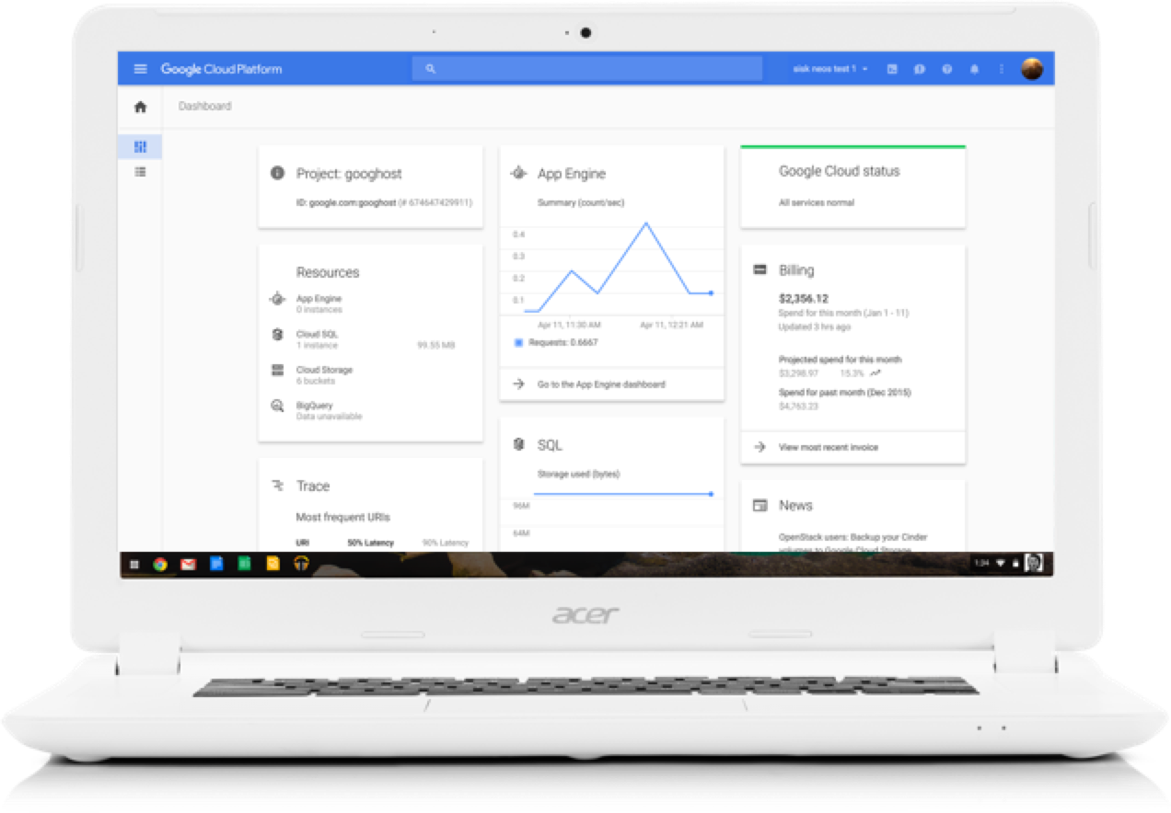
The GCP Console provides a web-based GUI for you to manage your GCP projects and resources
 | Centralized console for all project data.
 | Execute common tasks using simple mouse clicks.
 | Manage and create projects.
 | Access developer tools: Cloud Source Repositories Cloud SDK Cloud Shell
 | Access to product APIs.
Copyright Google LLC. For educational purposes in accordance with the terms of use set forth on the program Website.
Notes:
The GCP Console serves as a centralized console for all of your project data, and lets you execute common tasks using simple mouse clicks with no need to remember commands or avoid typos.
When you use the GCP Console, the resources that you create are done so in the context of a specific project. You can create multiple projects, so you can use projects to separate your work in whatever way makes sense for you. For example, you might start a new project if you want to make sure only certain team members can access the resources in that project, while all team members can continue to access resources in another project.
The GCP Console is also great for developers. Cloud Source Repositories provides Git version control to support collaborative development of any application or service.
The Cloud SDK is a set of command-line tools for GCP. You can run these tools interactively or in your automated scripts.
Cloud Shell also provides you with command-line access to your cloud resources directly from your browser, but without having to install the Cloud SDK or other tools on your system. The utilities you need are always available, up to date and fully authenticated when you need them.
Cloud SDK and Cloud Shell will be discussed in more detail later in this module.
The Cloud SDK includes client libraries that enable you to easily create and manage resources. GCP client libraries expose APIs for two main purposes. App APIs provide access to services and admin APIs offer functionality for resource management.

Slide 31
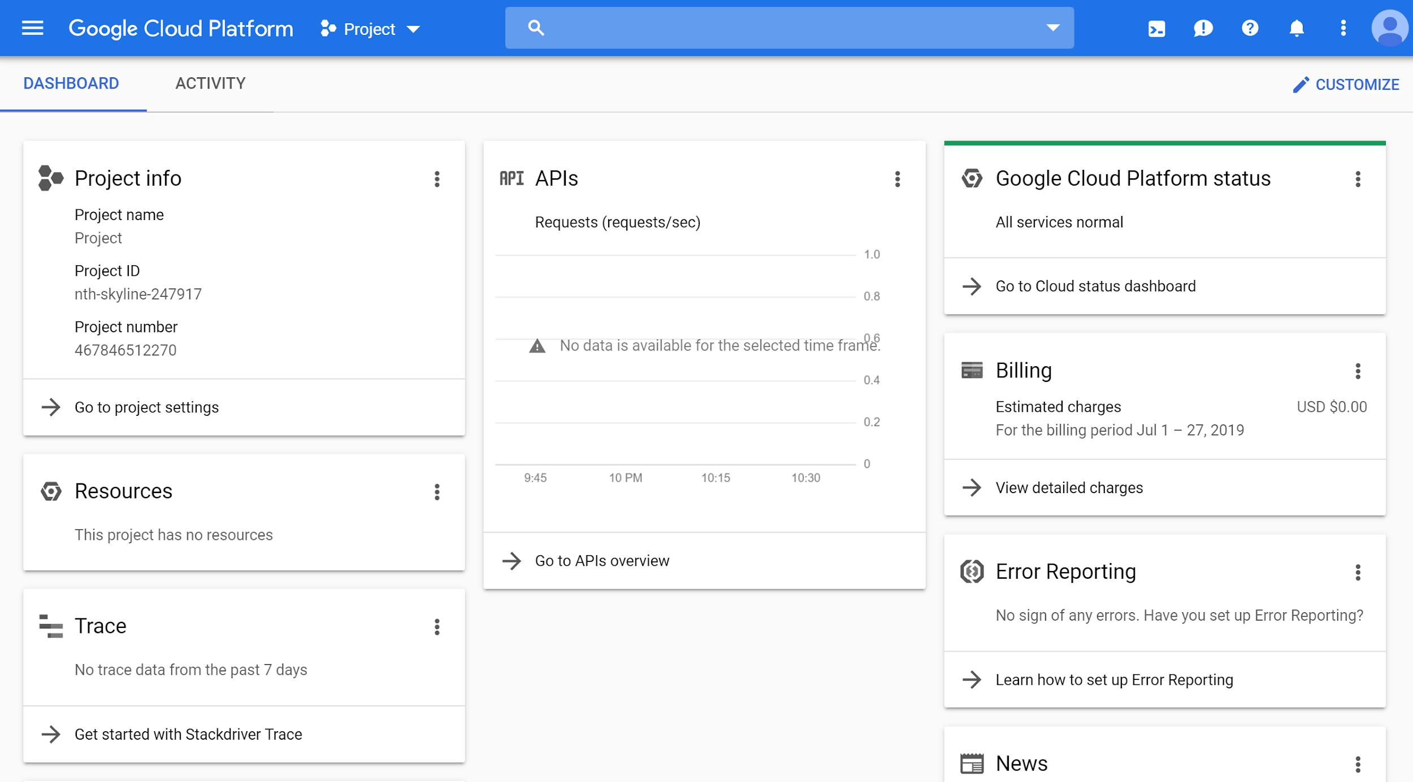
Logging in to the GCP Console
http://www.console.google.com
Copyright Google LLC. For educational purposes in accordance with the terms of use set forth on the program Website.
Notes:
From a browser, go to console.cloud.google.com. If you haven’t already logged into your Google account, the system will prompt you to enter your credentials. After you log in, the GCP Console will display the details of your default project.

Slide 32
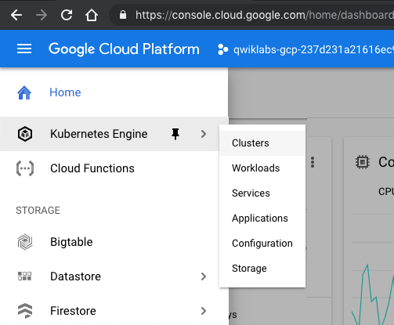
Interacting with the GCP Console
Copyright Google LLC. For educational purposes in accordance with the terms of use set forth on the program Website.
Notes:
All GCP services are accessible through the simple menu button in the top-left corner. You can pin frequently used services to this menu.

Slide 33
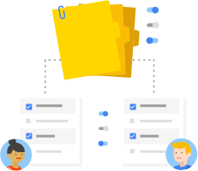
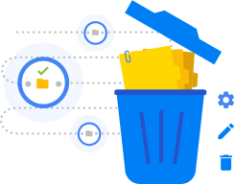
Every GCP service you use is associated
with a project
 | Enable services and APIs.
 | Enable billing.
 | Manage permissions and credentials.
 | Track resource and quota usage.
 | Programmatically manage your projects in GCP.
Copyright Google LLC. For educational purposes in accordance with the terms of use set forth on the program Website.
Notes:
Projects are the basis for enabling and using GCP services, like managing APIs, enabling billing, adding and removing collaborators, and enabling other Google services. Each project is a separate account, and each resource belongs to exactly one. Projects can have different owners and users. They’re billed separately, and they’re managed separately.
Resource Manager provides ways for you to programmatically manage your projects in GCP. You can access Resource Manager through an RPC API or REST API. With these APIs, you can get a list of all projects associated with an account, create new projects, update existing projects, and delete projects. You can also undelete, or recover, projects that you want to restore.

Slide 34
Obtain $50 Credit
Follow the link shared on Slack to get the $50 coupon. Make sure to sign up with your BU email address and NOT your personal Gmail account.
Please DO NOT provide your credit card information for the purpose of this course!

Slide 35
Projects have three identifying attributes
Project ID
Project name
Project number
Globally unique
Need not be unique
Globally unique
Assigned by GCP but mutable during creation
Chosen by you
Assigned by GCP
Immutable after creation
Mutable
Immutable
Copyright Google LLC. For educational purposes in accordance with the terms of use set forth on the program Website.
Notes:
Each GCP project has a name and project ID that you assign. The project ID is a permanent, unchangeable identifier, and it has to be unique across GCP. While a Project ID will be generated automatically, you can edit it. However, this must be done while creating the new project though as it cannot be modified afterwards. In general, project IDs are made to be human-readable strings, and you’ll use them frequently to refer to projects.
On the other hand, project names are for your convenience, and you can change them. Note though that you can’t reuse the project name of a deleted project.
GCP also assigns each of your projects a unique project number, and you’ll see it displayed to you in various contexts, but using it is mostly outside the scope of this course.
As you work with GCP, you'll use these identifiers in certain command lines and API calls.

Slide 36
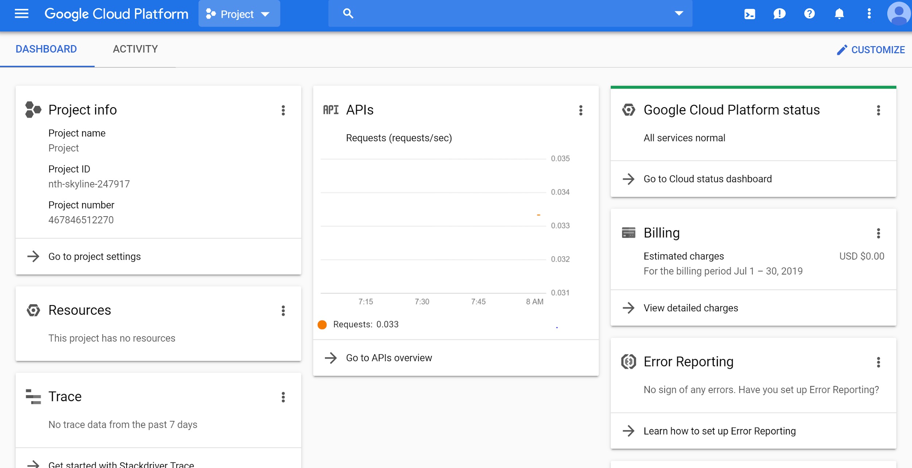
Creating a project
http://www.console.google.com
Copyright Google LLC. For educational purposes in accordance with the terms of use set forth on the program Website.
Notes:
To create a project, click on the name of the current project in the upper left portion of the screen.

Slide 37
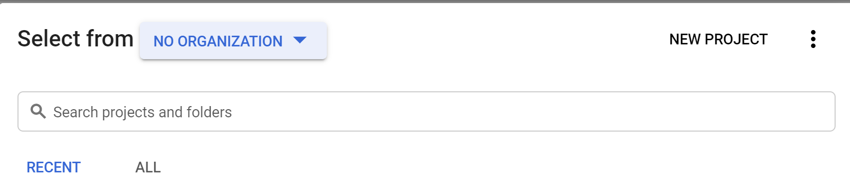
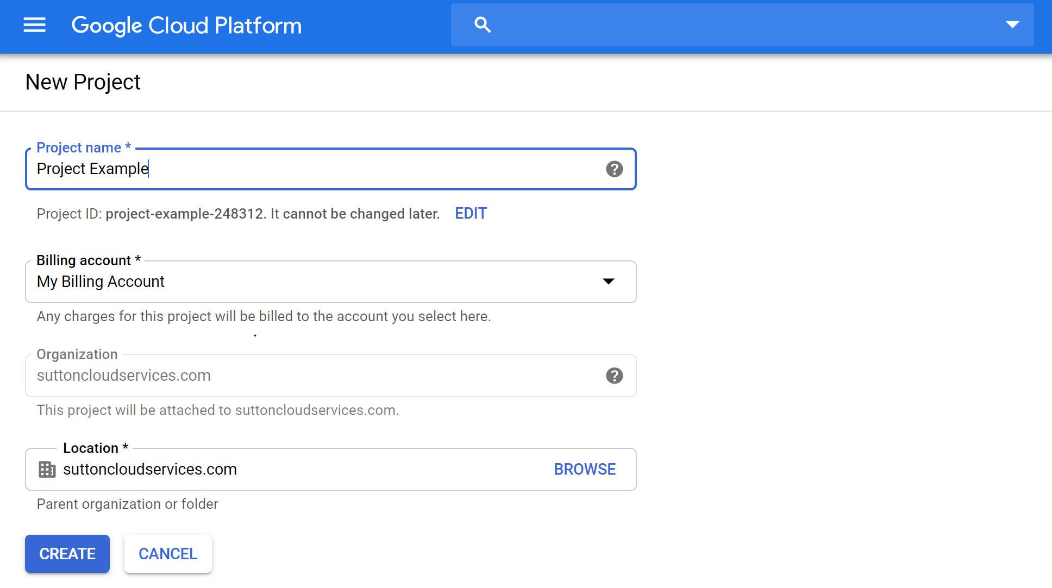
Creating a project
Copyright Google LLC. For educational purposes in accordance with the terms of use set forth on the program Website.
Notes:
A list of all current projects will be displayed. Select the New Project option on the right-hand side.
When the New Project screen is displayed, give your project a name. You have the option to use the auto-generated project ID, or create your own by clicking the Edit option. Project IDs must be globally unique. Select the appropriate billing account and organization and then click Create.

Slide 38
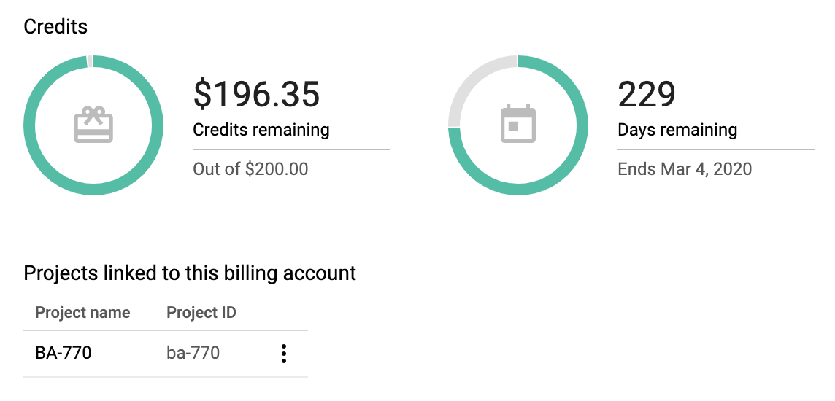
Create a project
Login: https://console.cloud.google.com
Set up a project
Give the project a name; something like BA775
From Google Cloud Platform menu go to Billing > Go to linked billing account (if you have more than one) > Account management.. Make sure that you see your project name under the $50 coupon

Slide 39
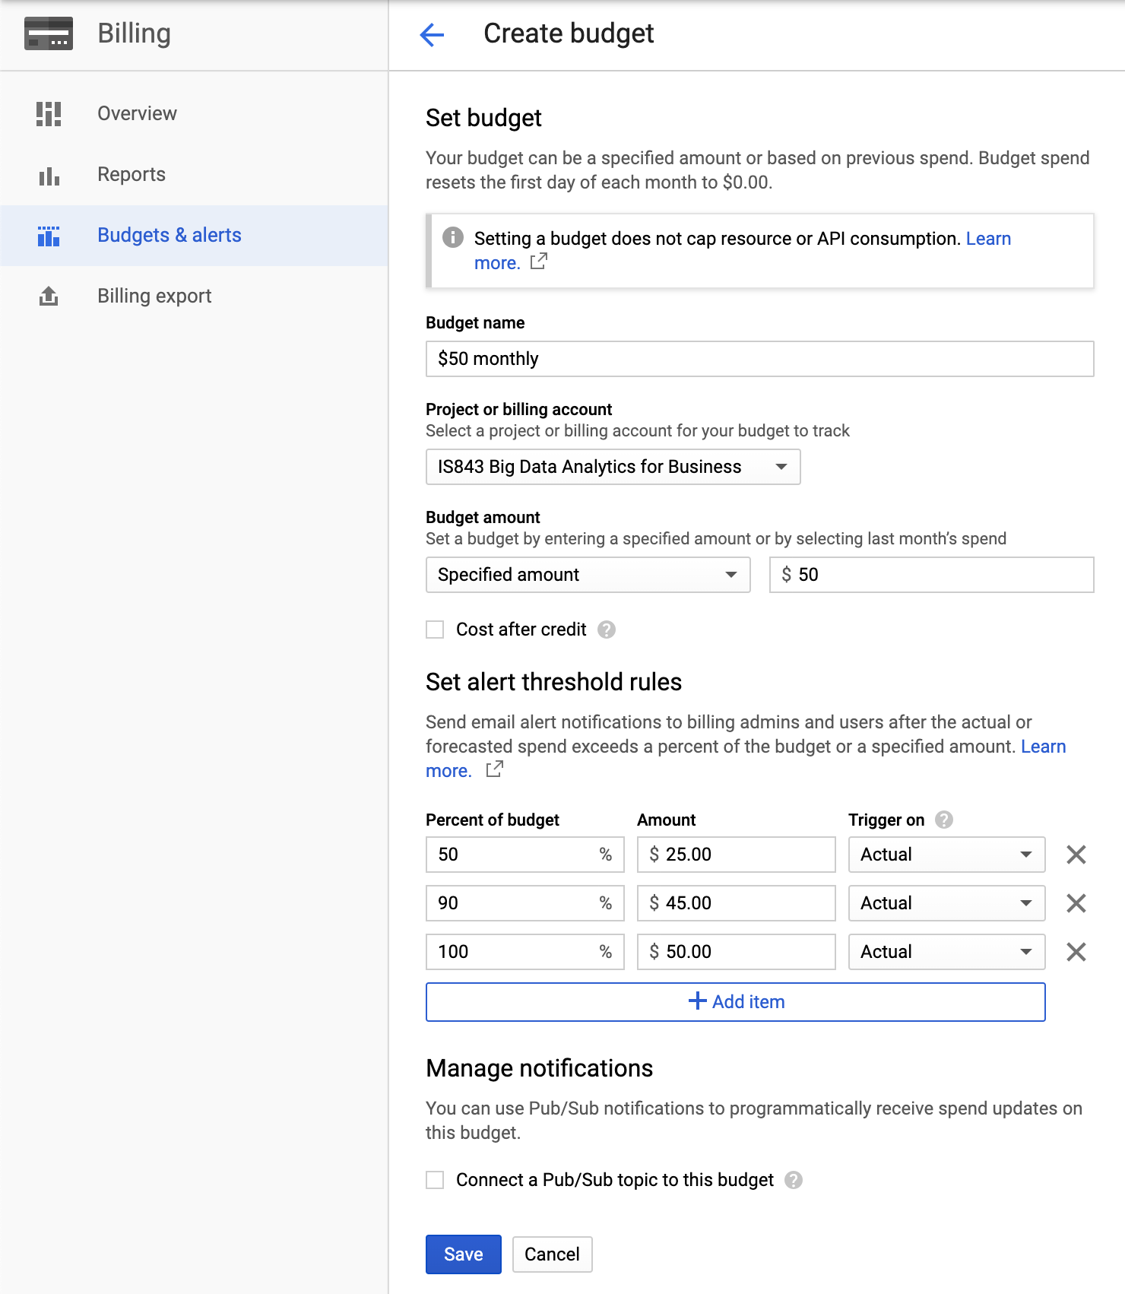
Budgets and Alerts
Go to Billing > Go to linked billing account > Budgets and alerts > Create a budget
Set the followings:
Budget name
Budget amount (E.g. $20/month)
Percent of budget to receive notifications

Slide 40

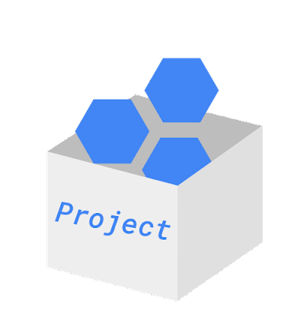
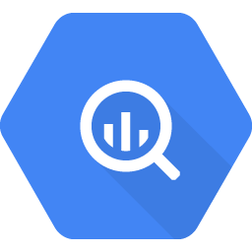
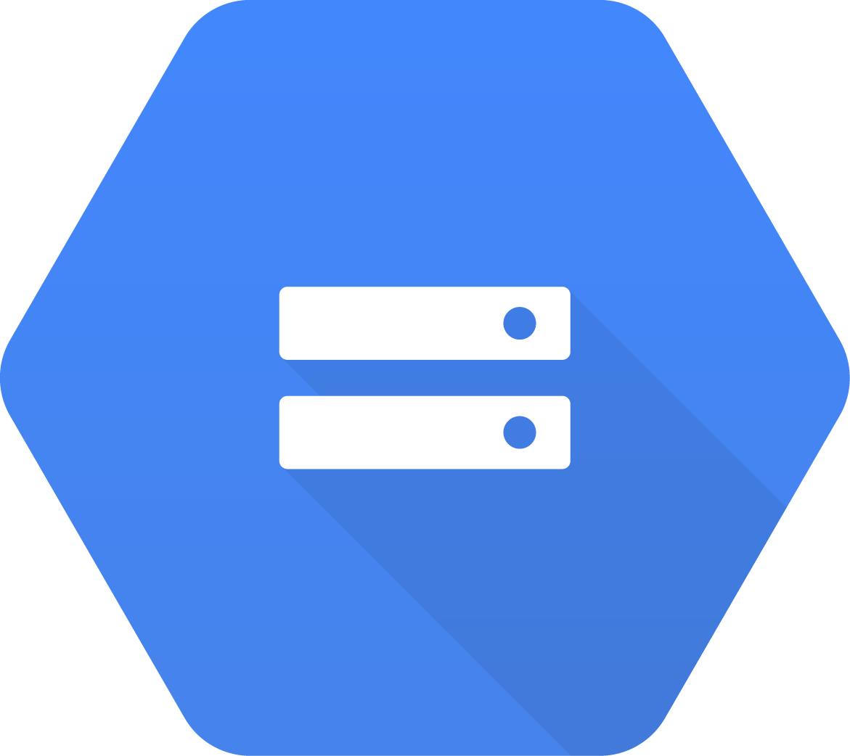
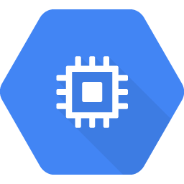
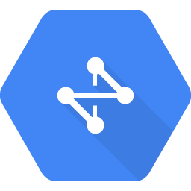
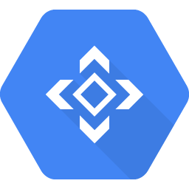
How billing works
Billing account pays for project resources.
A billing account is linked to zero or more projects.
Accounts are charged automatically, invoiced monthly, or invoiced at the threshold limit.
BigQuery
Cloud Storage
VMs
Cloud Network
Cloud
APIs
Sub accounts can be used for separate billing for projects.
Copyright Google LLC. For educational purposes in accordance with the terms of use set forth on the program Website.
Notes:
Billing in GCP is set up at the GCP project level. When you define a GCP project, you link a billing account to it. This billing account is where you will configure all your billing information, including your payment option.
You can link your billing account to zero or more projects. Projects that you don’t link to any billing account can only use free GCP services.
Your billing account can be charged automatically and invoiced every month, or at every threshold limit.
You can separate project billings by setting up billing subaccounts. Some GCP customers who resell GCP services use sub accounts for each of their own clients.

Slide 41
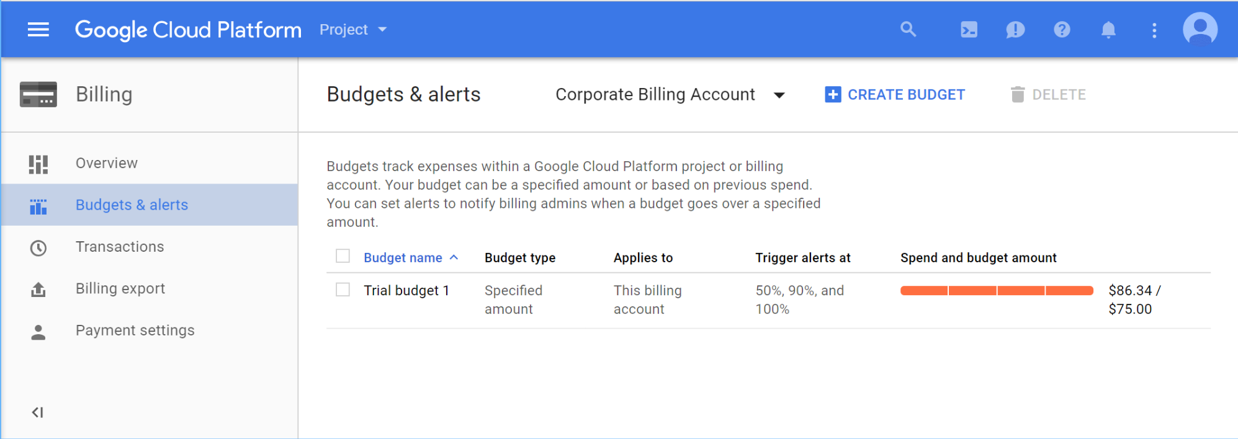
Budgets and alerts keep your billing under control
Copyright Google LLC. For educational purposes in accordance with the terms of use set forth on the program Website.
Notes:
You can define budgets at the billing account level or at the project level.
To be notified when costs approach your budget limit, you can create an alert. For example, with a budget limit of $20 and an alert set at 90%, you’ll receive a notification alert when your expenses reach $18.
You can also set up a webhook to be called in response to an alert. This webhook can control automation based on billing alerts. For example, you could trigger a script to shutdown resources when a billing alert occurs.

Slide 42

Quotas are helpful limits
Rate quota
GKE API: 1,000 requests per 100 seconds
Allocation quota
5 networks per project
Many quotas are changeable
Copyright Google LLC. For educational purposes in accordance with the terms of use set forth on the program Website.
Notes:
GCP also implements quotas, which limit unforeseen extra billing charges. Quotas are designed to prevent the over-consumption of resources because of an error or a malicious attack.
Quotas apply at the level of the GCP project.
There are two types of quotas: rate quotas and allocation quotas. Rate quotas reset after a specific time. For example, by default, the Google Kubernetes Engine service implements a quota of 1,000 calls to its API from each GCP project every 100 seconds.
Allocation quotas govern the number of resources you can have in your projects. For example, depending on the region, the number of GPUs permitted varies by type and region.
You can change quotas by requesting an increase from Google Cloud Support. You can also use the console to request a quota change.
GCP quotas also protect the community of GCP users by reducing the risk of unforeseen spikes in usage.

Slide 43
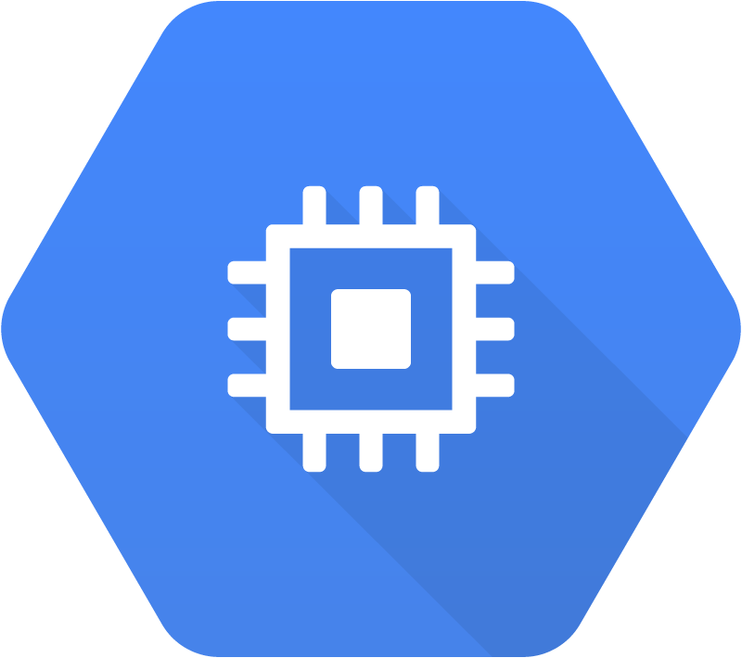
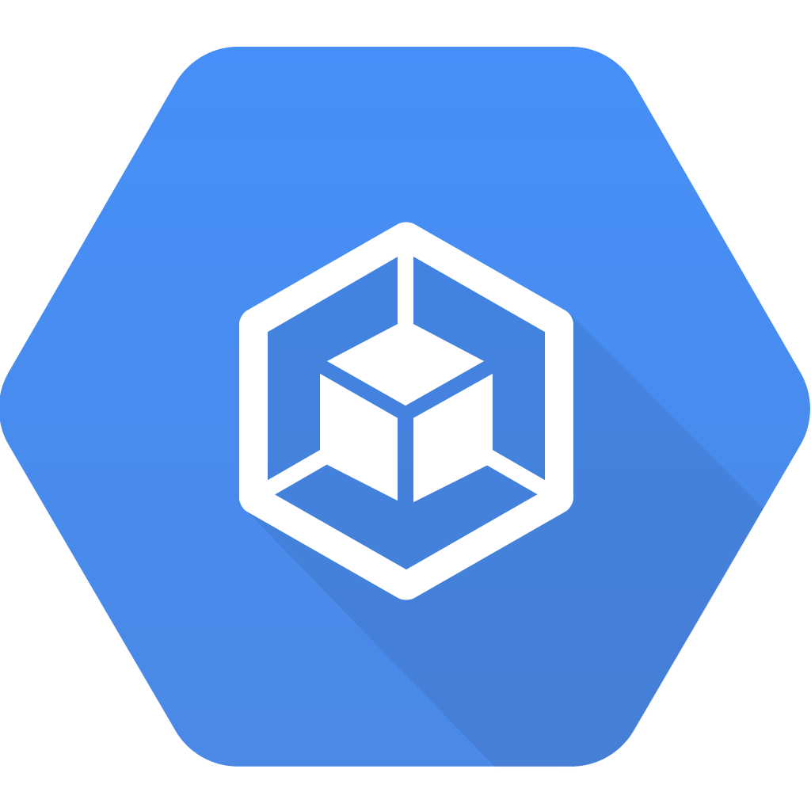
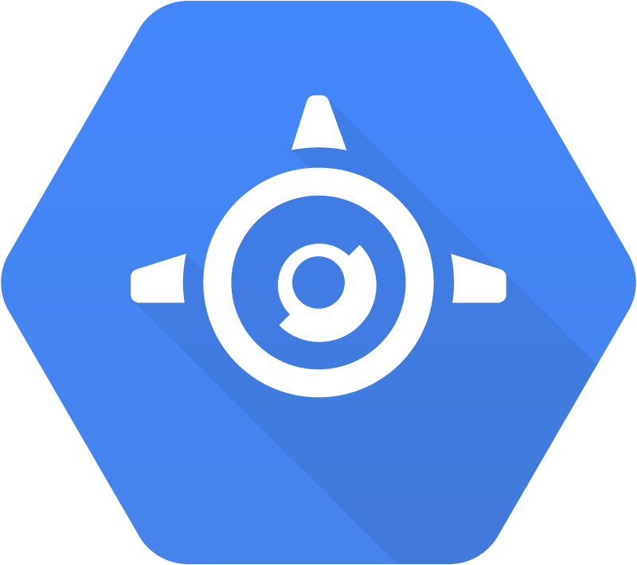
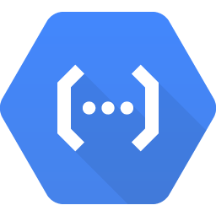
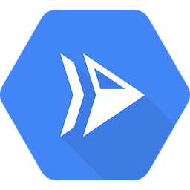
GCP offers a range of compute services
Compute
Compute
Engine
Google Kubernetes Engine (GKE)
App Engine
Cloud
Functions
Cloud
Run
(Beta)
Copyright Google LLC. For educational purposes in accordance with the terms of use set forth on the program Website.
Notes:
Google Cloud Platform’s products and services can be broadly categorized as Compute, Storage, Big Data, and Machine Learning. Leveraging compute can include virtual machines via Compute Engine, running Docker containers in a managed platform using Google Kubernetes Engine, deploying applications in a managed platform like App Engine, running event-based serverless code using Cloud Functions, or running stateless containers as a managed service like Cloud Run.

Slide 44
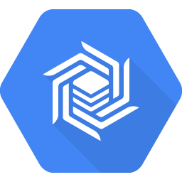
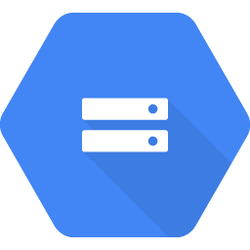
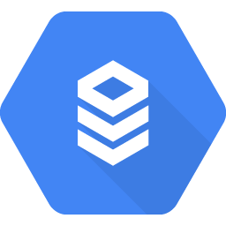
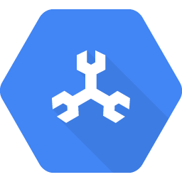
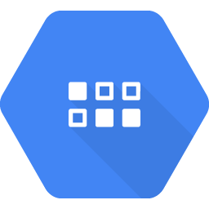
GCP also offers a range of storage services
Storage
Cloud Bigtable
Cloud Storage
Cloud
SQL
Cloud
Spanner
Cloud
Datastore
Copyright Google LLC. For educational purposes in accordance with the terms of use set forth on the program Website.
Notes:
A variety of managed storage options are available as well. For unstructured storage there’s Cloud Storage, for managed relational databases there’s Cloud SQL or Cloud Spanner, and for NoSQL, there are options like Cloud Datastore or Cloud Bigtable.

Slide 45









Google Cloud offers services to get value from data
Big data
BigQuery
Pub/Sub
Dataflow
Dataproc
AI Platform Notebooks
Machine learning
AI Platform
Vision API
Speech-to-Text API
Cloud Translation API
AutoML
Copyright Google LLC. For educational purposes in accordance with the terms of use set forth on the program Website.
Notes:
Managed services dealing with big data and machine learning are available as well.

Slide 46
Google Cloud Platform
134 points of presence and 13 subsea cable investments around the globe
Faster (US, JP, TW) 2016
Unity (US, JP) 2010
Havfrue (US, IE, DK) 2019
Edge points
of presence
Dunant (US, FR) 2020
PLCN (HK, LA) 2019
Network
Curie (CL, US) 2019
HK-G (HK, GU) 2019
JGA (AU, GU, JP) 2019
SJC (JP, HK, SG) 2013
Monet (US, BR) 2017
Junior (Rio, Santos) 2018
Tannat (BR, UY, AR) 2018
Indigo (SG, ID, AU) 2019
Copyright Google LLC. For educational purposes in accordance with the terms of use set forth on the program Website.
Notes:
Google’s data centers around the world are interconnected by the Google network, which, by some publicly available estimates, carries as much as 40% of the world’s internet traffic every day. This is the largest network of its kind on Earth, and it continues to grow.
It’s designed to provide the highest possible throughput and the lowest possible latencies for applications.
The network interconnects with the public internet at more than 90 internet exchanges and more than 110 points of presence worldwide. When an internet user sends traffic to a Google resource, Google responds to the user's request from an Edge Network location that will provide the lowest delay or latency. Google’s edge caching network places content close to end users to minimize latency. Applications in GCP can take advantage of this edge network too.

Slide 47



Google Cloud provides resources in multi-regions, regions, and zones
Multi-Region
Region
Zone
europe-west2-a
europe-west2-b
europe-west2-c
US
Europe
europe-west2
Copyright Google LLC. For educational purposes in accordance with the terms of use set forth on the program Website.
Notes:
Google Cloud divides the world into three multi-regional areas: the Americas, Europe, and Asia Pacific.
Next, the three multi-regional areas are divided into regions, which are independent geographic areas on the same continent. Within a region, there’s fast network connectivity: generally round-trip network latencies of under 1 millisecond (that is, at the 95th percentile).
Finally, regions are divided into zones, which are deployment areas for GCP resources within a focused geographic area. You can think of a zone as a data center within a region, although strictly speaking a zone isn’t necessarily a single data center.
Compute Engine virtual-machine instances reside within a specific zone. If that zone became unavailable, so would your virtual machine and the workload running on it.
Deploying applications across multiple zones enables fault tolerance and high availability.

Slide 48
Google Cloud Platform
Announced regions
3
Finland
Netherlands
Oregon
London
3
3
3
Frankfurt
3
3
Montréal
3
3
Seoul
Salt Lake City
3
Belgium
Zurich
3
3
Tokyo
Iowa
4
N. Virginia
Osaka
3
Los Angeles
3
3
3
Current regions and number of zones
S. Carolina
Hong Kong
3
3
Taiwan
3
Mumbai
Future regions
and number of zones
3
Singapore
Jakarta
3
São Paulo
3
3
Sydney
Copyright Google LLC. For educational purposes in accordance with the terms of use set forth on the program Website.
Notes:
Behind the services provided by the Google Cloud Platform lie a huge range of GCP resources: physical assets, such as physical servers and hard disk drives; and virtual resources, such as virtual machines and containers. These resources are managed by Google within its global data centers. As of mid-2019, GCP has expanded across 20 regions, 61 zones, and more than 200 countries and territories. This expansion will continue.

Slide 49




Resources are organized both physically and logically
Global
HTTP(S) load balancer
Virtual Private Cloud
Regional
Regional
Regional GKE cluster
Cloud
Datastore
Zonal
Zonal
Persistent Disk
GKE
node
Compute Engine instance
Persistent
Disk
Physical organization
Copyright Google LLC. For educational purposes in accordance with the terms of use set forth on the program Website.
Notes:
When you take advantage of GCP services and resources, you get to specify those resources’ geographical locations. In many cases you can also specify whether you’re doing so on a zonal level, a regional level, or a multi-regional level.
Zonal resources operate within a single zone, which means that if a zone becomes unavailable, the resources won’t be available either. A simple example would be a Compute Engine virtual machine instance and its persistent disks. GKE has a component called a “node,” and these are zonal too.
Regional resources operate across multiple zones, but within one region. An application using these resources can be redundantly deployed to improve its availability.
Finally, global resources can be managed across multiple regions. These resources can further improve the availability of an application. Some examples of such resources include HTTPS load balancers and Virtual Private Cloud networks.

Slide 50


Resources are organized both physically and logically
Project-1
Global
HTTP(S) load balancer
Virtual Private Cloud
Regional
Regional
Regional GKE cluster
Cloud
Datastore
Zonal
Zonal
Persistent Disk
GKE
node
Compute Engine instance
Persistent
Disk
Physical organization
Logical organization
Copyright Google LLC. For educational purposes in accordance with the terms of use set forth on the program Website.
Notes:
The GCP resources you use, no matter where they reside, must belong to a project. So what is a project?
A project is the base-level organizing entity for creating and using resources and services and managing billing, APIs, and permissions. Zones and regions physically organize the GCP resources you use, and projects logically organize them. Projects can be easily created, managed, deleted, or even recovered from accidental deletions.

Slide 51

Resources have hierarchy
Organization
Organization
Folders
Team A
Team B
Product 1
Product 2
Projects
Store front
Test project
Production
Resources
GKE
Cloud Storage bucket
Compute Engine instance
App Engine service
Copyright Google LLC. For educational purposes in accordance with the terms of use set forth on the program Website.
Notes:
Each project is identified by a unique project ID and project number. You can name your project and apply labels for filtering. These labels are changeable, but the project ID and project number remain fixed.
Projects can belong to a “folder” which is another grouping mechanism.
You should use folders to reflect the hierarchy of your enterprise and apply policies at the right levels in your enterprise. You can nest folders inside folders. For example, you can have a folder for each department, and within each department’s folder, you can have subfolders for each of the teams that make it up. Each team’s projects belong to its folder.
A single organization owns the folders beneath it. An organization is the root node of a GCP resource hierarchy. Although you are not required to have an organization to use GCP, organizations are very useful. Organizations let you set policies that apply throughout your enterprise. Also, having an organization is required to use folders.
The GCP resource hierarchy helps you manage resources across multiple departments and multiple teams within an organization.
You can define a hierarchy that creates trust boundaries and resource isolation. For example, should members of your Human Resources team be able to delete running database servers? And should your engineers be able to delete the database containing employees’ salaries? Probably not, in either case!
Cloud Identity and Access Management, also called Cloud IAM ***I-A-M*** , lets you fine-tune access control to all the GCP resources you use. You define IAM policies that control user access to resources.

Slide 52

Getting Data Into the Cloud…
Photo credit

Slide 53

Structured versus unstructured data
Unstructured data
Transactions
First_Name | Last_Name | Address | City | Age
Sherlock | Holmes | 12 Main St | Mesa | 60
James | Bond | 23 Old St | Napa | 43
Scarlett | O’Hara | 34 New St | Derby | 23
Marge | Simpson | 56 West St | Cody | 36
Voice transcriptions
Online communities
Notes & text fields
Structured data
Ratings & reviews
Social media
Call center
Email
Chat
Surveys
Copyright Google LLC. For educational purposes in accordance with the terms of use set forth on the program Website.

Slide 54
What type of storage will meet my needs best?
Is your data structured?
No
?
Yes
Cloud Storage
Is your workload analytics?
?
Yes
No
Do you need horizontal scalability?
Is your data relational?
Do you need updates or low latency?
?
Yes
?
?
No
Yes
No
Yes
No
Cloud SQL
Cloud Spanner
Cloud Datastore
Cloud Bigtable
BigQuery
Copyright Google LLC. For educational purposes in accordance with the terms of use set forth on the program Website.

Slide 55


Create Cloud Storage Bucket
Go to STORAGE > Storage > CREATE BUCKET
Give it a name; for instance ba775-xx, where xx are your initials.
Note: Bucket names are universally unique.

Slide 56
Cloud Storage - Upload Files
Cloud storage buckets through the UI work very similar to a Dropbox folder.
Upload data/GOT-battles.csv to the bucket you just created.
NOTE: Everyone in your project has visibility to your bucket, avoid uploading sensitive and private information.

Slide 57

Google Cloud Console
This is the web console and central development hub for GCP.
http://console.cloud.google.com will take you to GCP console. Everytime you land on a new GCP page make sure that are using your BU account as it could have unintended consequences!

Slide 58

Cloud Shell
Cloud Shell is an in-browser command prompt execution environment that allows you to enter commands at a terminal prompt to manage resources and services in your GCP project.

Slide 59


Start a Compute Engine
Go to COMPUTE > Compute Engine > Create a new instance
Provide a name
Leave the rest of the defaults unchanged
Notice the estimated monthly charge on the top
You will be charged based on the seconds
the service was used
Note: Don’t create one now. You will do it in the lab.
Alternatively, you can run this script in Cloud Shell.

Slide 60

DEMO
Setting up a Compute Engine instance

Slide 61

Terminate or Stop VM Instances
To avoid getting charged delete your instance:
From Compute Engine > VM Instances > select the instance you want to delete and press DELETE
Note: You can have 1 f1-micro instance running all the time at no cost. It’s a part of Google’s free tier.

Slide 62

DEMO
Creating a Vertex AI (AI Platform) instance

Slide 63
Qwiklabs
Please note you do NOT need to purchase any credits for the purpose of this course
Make sure to open Qwiklabs in Chrome and incognito mode
We will complete many labs during this course. You can also enrol for different Quests and get a badge upon completion of the Quest.

Slide 64

Activity
Apply for free Qwiklabs credits
Complete the Qwiklabs (A, B, and C) before the next class
Online Courses
Ch 1.1 Introduction to SQL - Selecting columns
Ch 1.2 Introduction to SQL - Filtering rows
Due Thursday - 08/12/21
Apply for Tableau license: https://www.tableau.com/academic/students
Quiz on Thursday

Slide 65

Your Turn - Lab Session
QLab A: A Tour of Qwiklabs and the Google Cloud Platform - 00:45
What you will learn in this lab
Qwiklabs platform
GCP console and project
Cloud IAM service
Cloud Shell & gcloud
API libraries
Popular command line text editors
**NOTE** OPEN QWIKLABS IN AN incognito MODE GOOGLE CHROME PAGE

Slide 66

Your Turn - Lab/Home
QLab B: Getting Started with Cloud Shell & gcloud - 00:30
What you will learn in this lab
More on Cloud Shell and gcloud
Accessing Cloud Storage through Cloud Shell
vi text editor
Note: Some labs come with videos, you can find them under the “Start Lab” button.
**NOTE** OPEN QWIKLABS IN AN incognito MODE GOOGLE CHROME PAGE

Slide 67
Your Turn - Home Session
QLab C*: Creating a Virtual Machine - 00:40
What you will learn in this lab
Create a virtual machine with the GCP Console
Create a virtual machine with gcloud command line
Deploy a web server and connect it to a virtual machine
**NOTE** OPEN QWIKLABS IN AN incognito MODE GOOGLE CHROME PAGE

